Slide 1
MySQL & PostgreSQL
Course 4: Week 3: RDBMS
CASCADE means that when rows are deleted or updated in the parent table, the corresponding rows in the child table will also be deleted or updated.
RESTRICT means that rows cannot be deleted or updated in the parent table if there are corresponding rows in the child table.

Slide 2
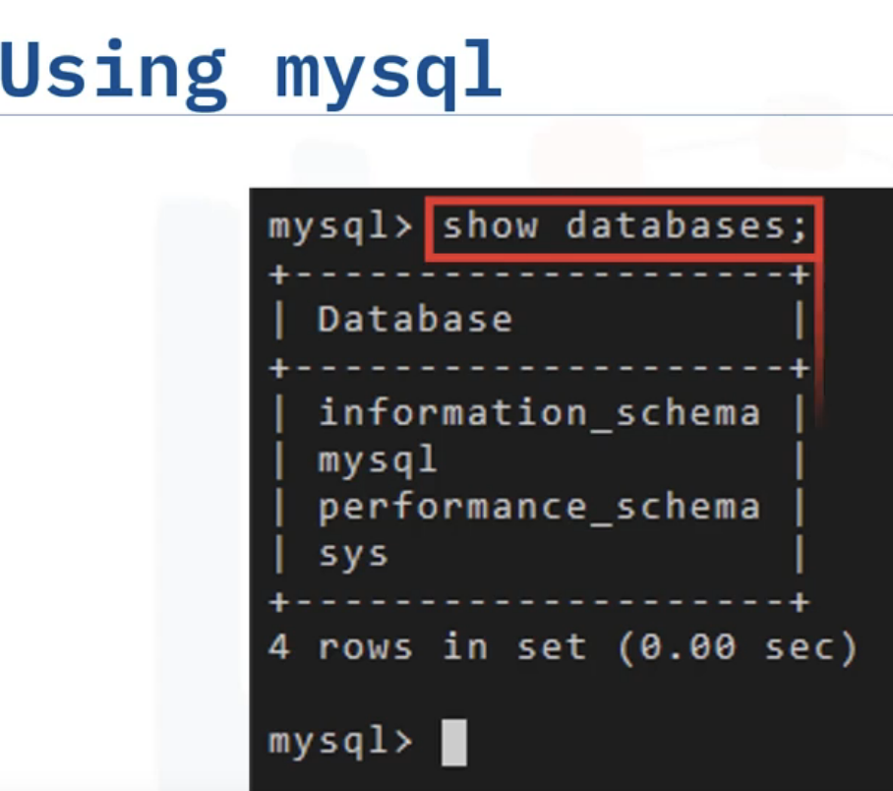
MySQL
Open source
Fork version- Maria DB
Community & Commercial editions
Also available on cloud managed versions of the same on GCP,AWS,AZURE using VMs and containers
MySQL Tools: mysql CLI, mysqladmin, MySQL Workbench (has graphical UI), phpMyAdmin

Slide 3
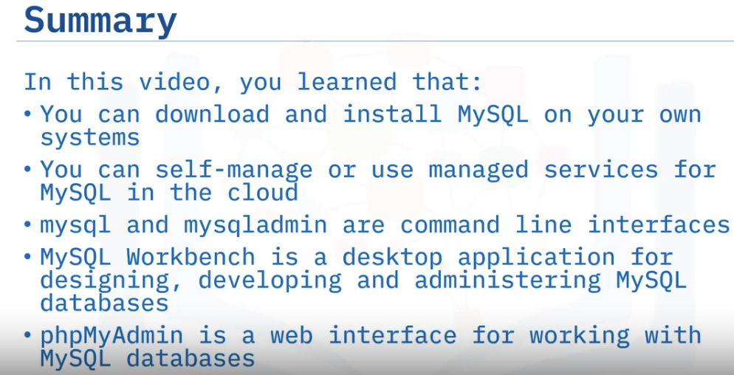

Slide 4
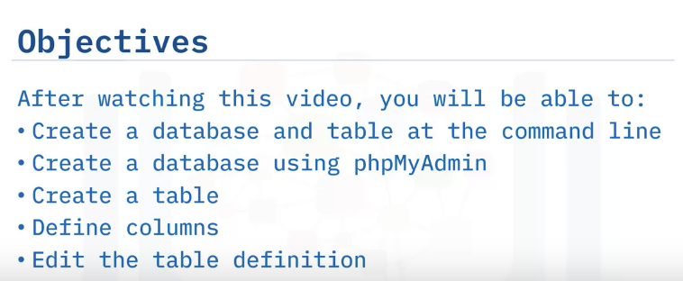
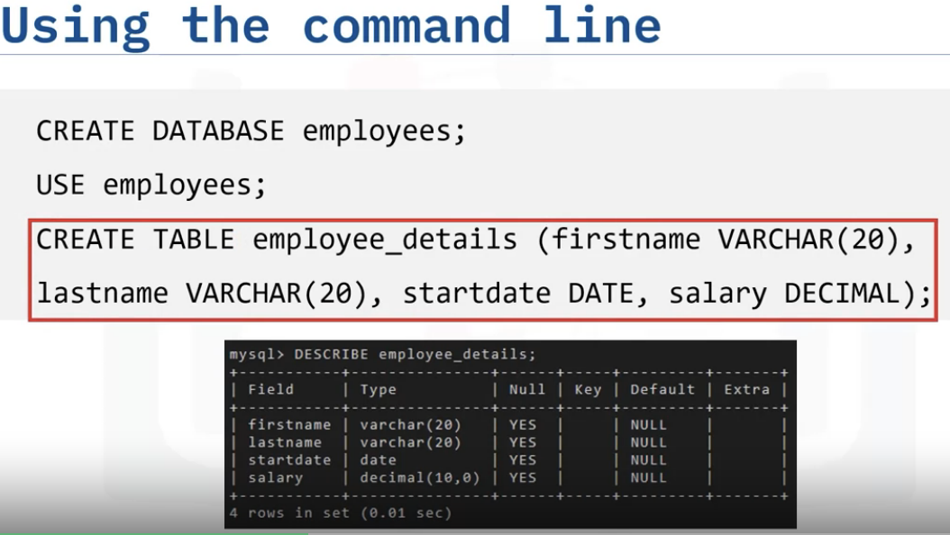
Creating Databases and Tables in MySQL

Slide 5
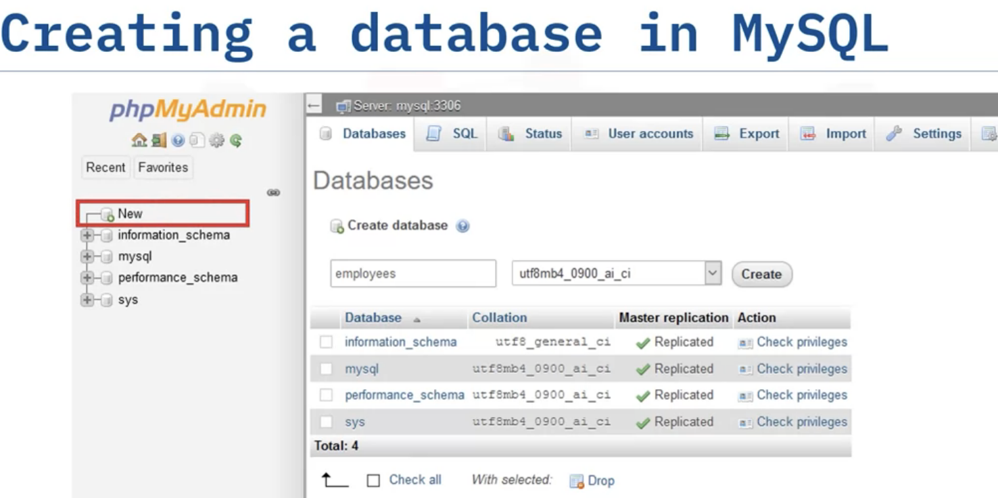
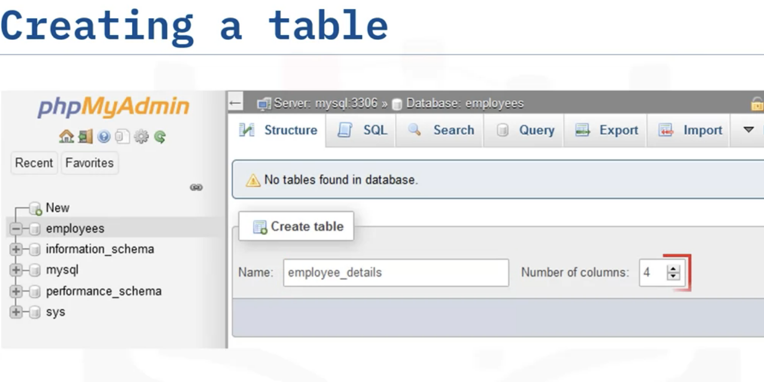

Slide 6
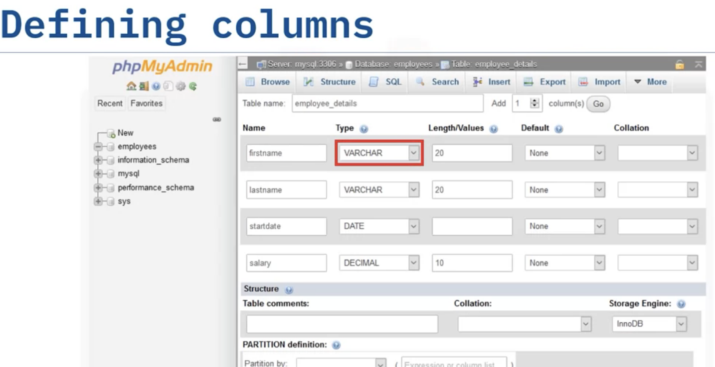
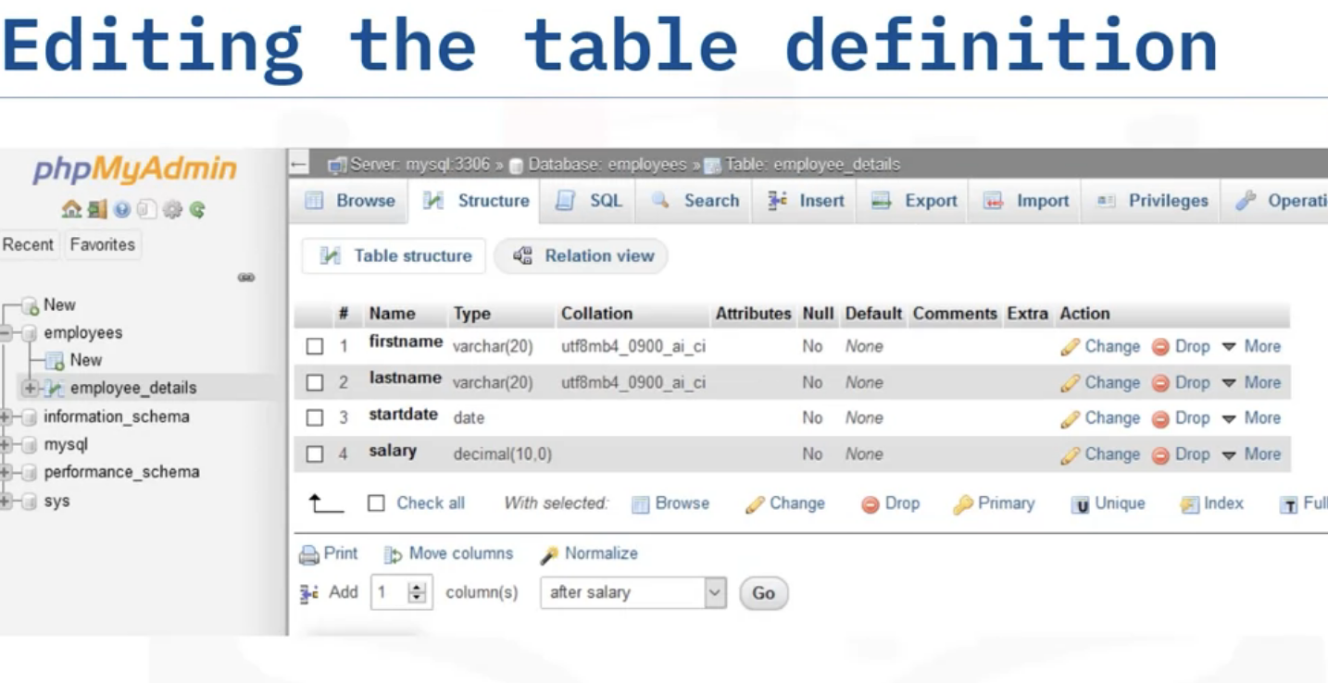
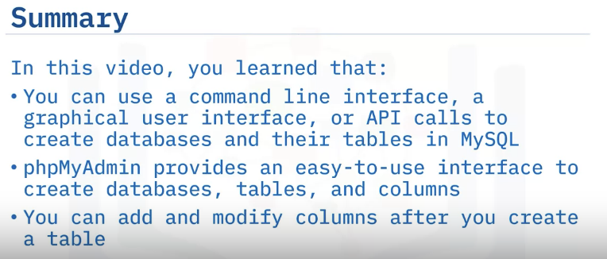

Slide 7
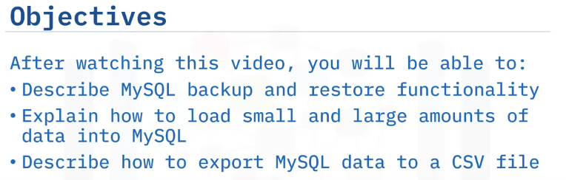
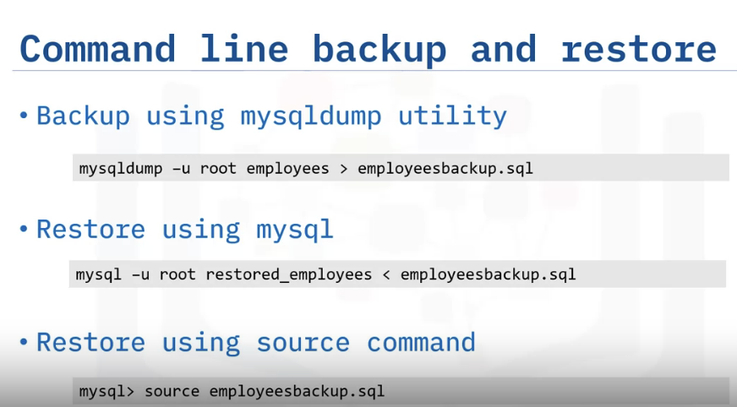
Loading Data in MySQL
User name of root
Database
Backup file name
Note that the greater than sign signifies output to the .sql file, or backup, and the less than sign signifies input to the database, or restore.

Slide 8
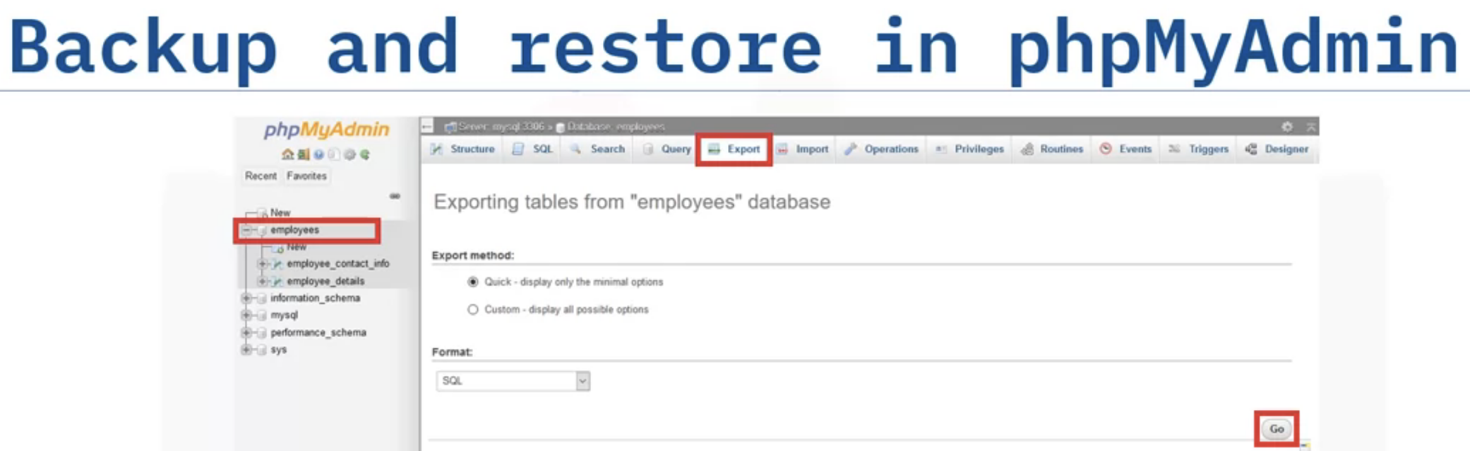
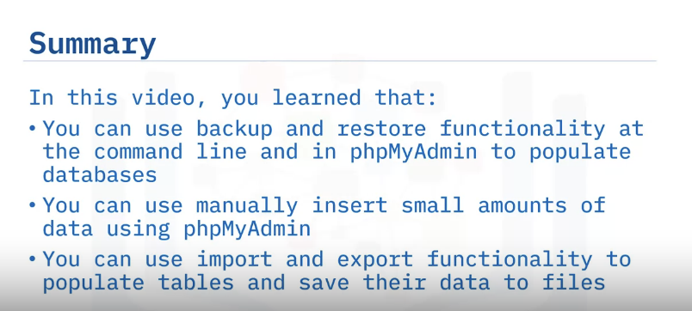

Slide 9
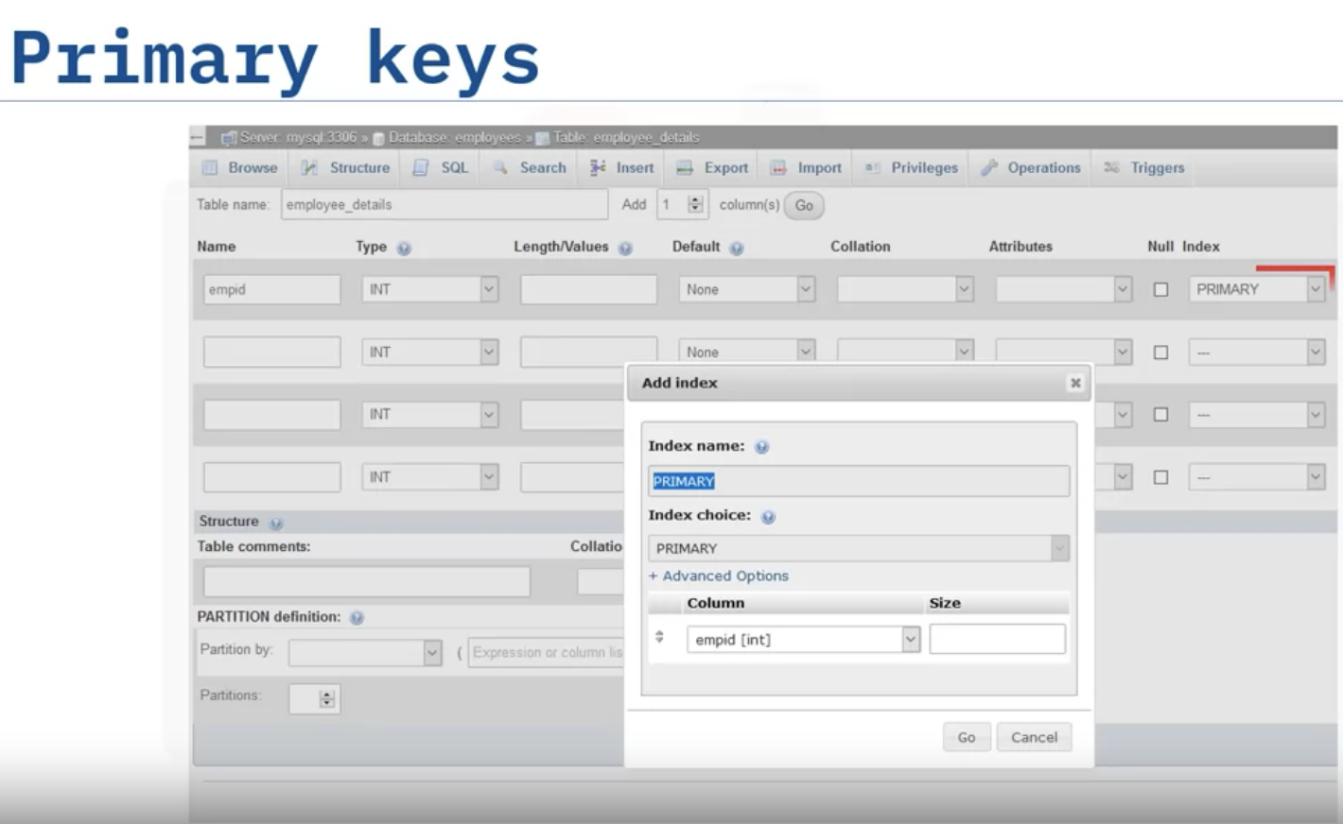
Using Keys and Constraints in MySQL

Slide 10
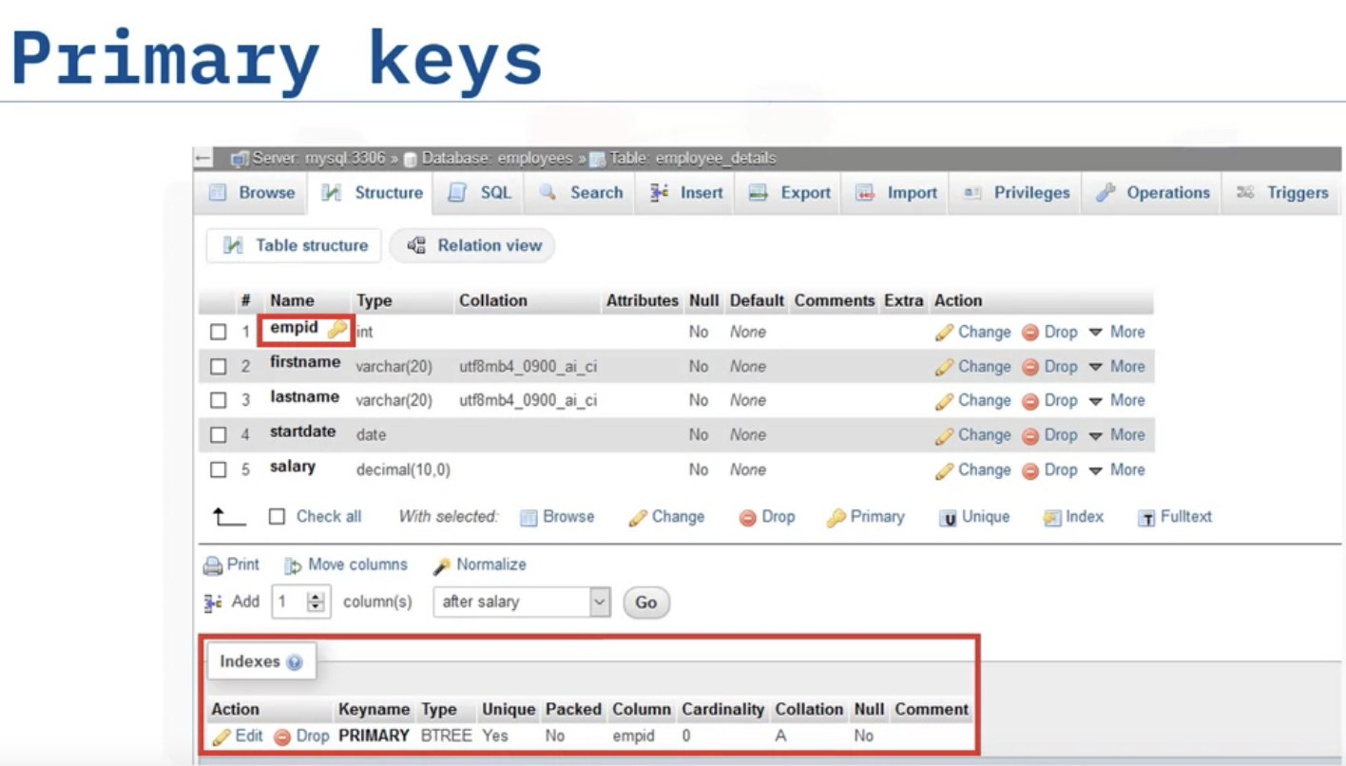

Slide 11
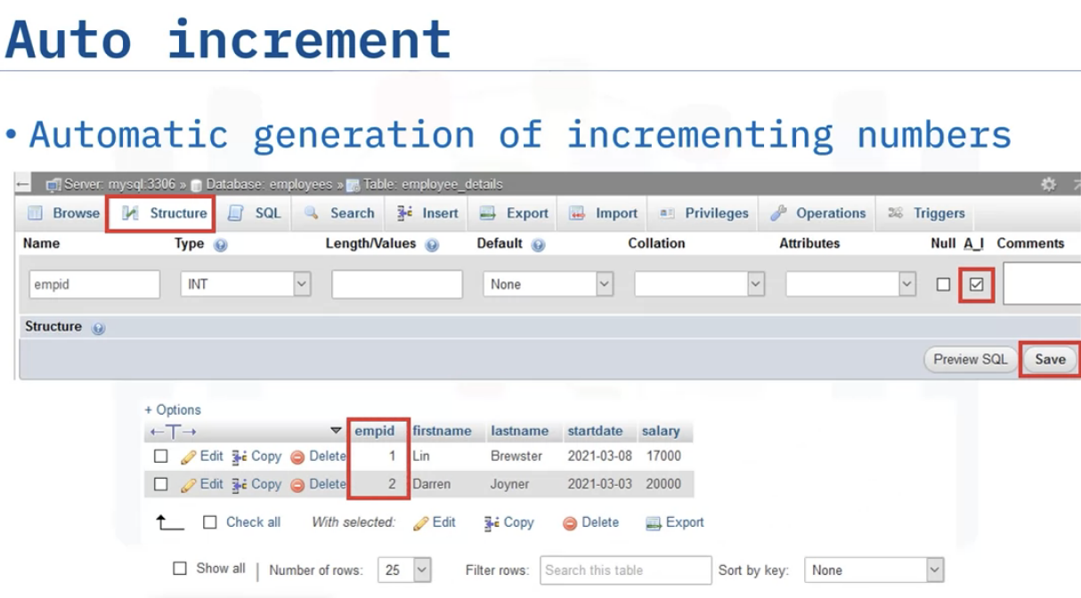
When we fill data, it will automatically asigns emp_id no. as it is a PK.

Slide 12
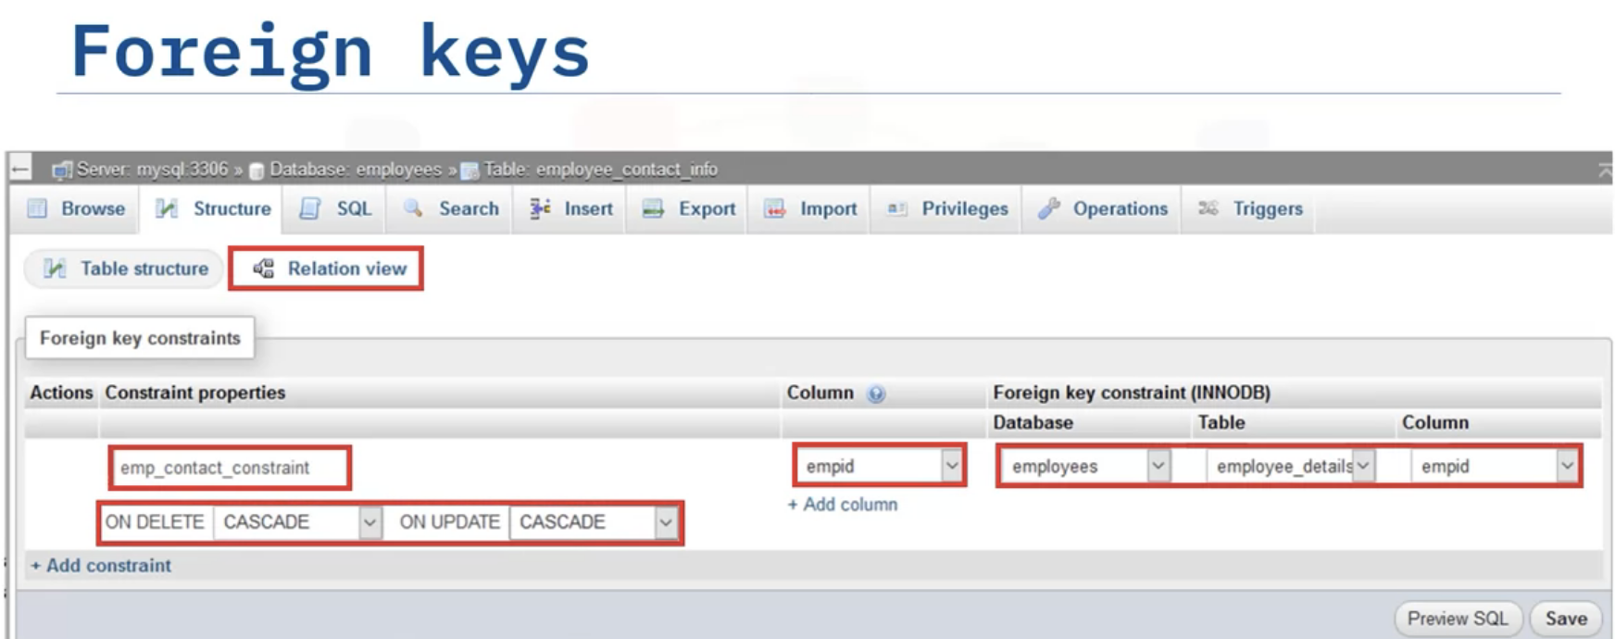
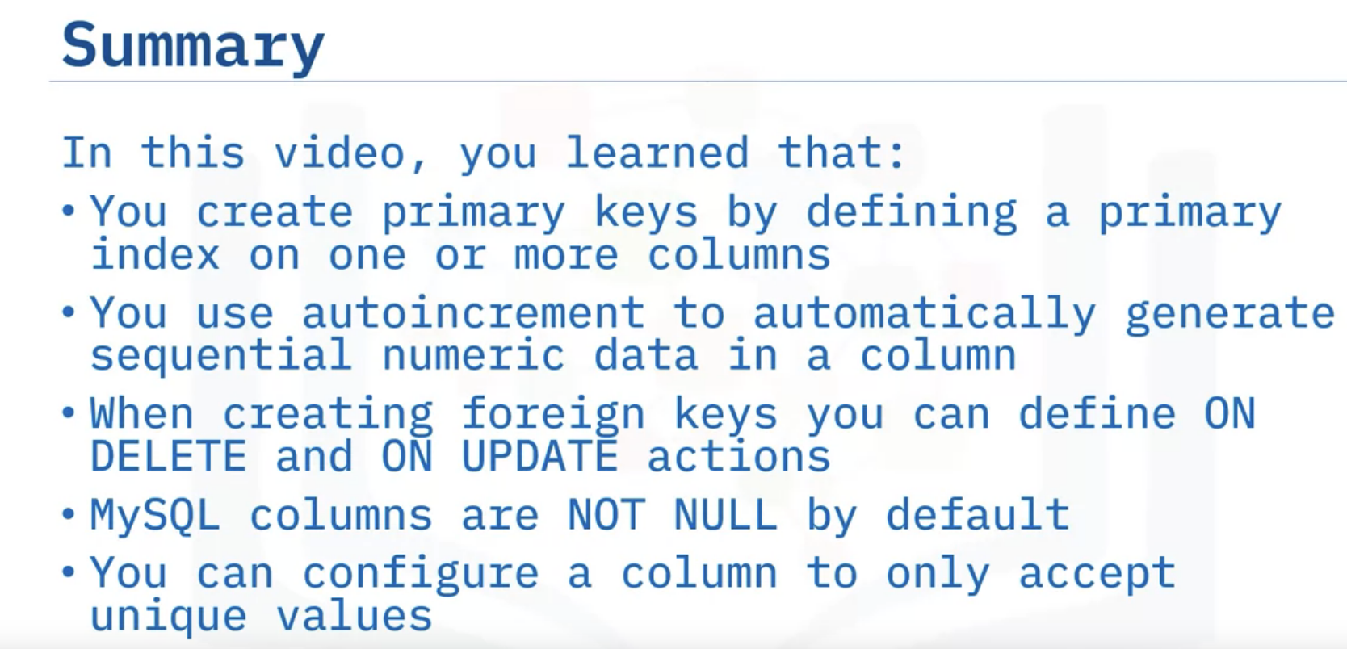

Slide 13
Summary & Highlights
MySQL is a free, open-source RDMS that you can download and install on your own systems or access on the Cloud.
You can either self-manage a Cloud instance of MySQL or use a managed services provider, including IBM Cloud, Amazon RDS for MySQL, Azure Database for MySQL, or Google Cloud SQL for MySQL.
MySQL includes several options for creating databases and tables, loading and querying data, and importing and exporting data relational databases:
mysql and mysqladmin command line interfaces. You use these CLIs to run SQL statements.
MySQL Workbench. A desktop application for designing, developing, and administering MySQL databases.
phpMyAdmin. An easy to use, third-party web interface for working with MySQL databases.
API calls.
Using phpMyAdmin, you can:
Add and modify columns after you create a table.
Use backup and restore functionality to populate databases.
Use import and export functionality to populate tables and save their data to files.
Create primary keys by defining a primary index on one or more columns.
Use autoincrement to automatically generate sequential numeric data in a column.
When creating foreign keys, you can define ON DELETE and ON UPDATE actions.
MySQL columns are NOT NULL by default.
You can configure a column to only accept unique values.

Slide 14
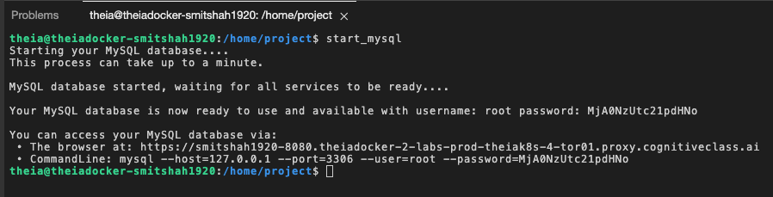
phpAdmin- Hands-on-lab
theia@theiadocker-smitshah1920:/home/project$ start_mysql
Starting your MySQL database....
This process can take up to a minute.
MySQL database started, waiting for all services to be ready....
Your MySQL database is now ready to use and available with username: root password: MjA0NzUtc21pdHNo
You can access your MySQL database via:
• The browser at: https://smitshah1920-8080.theiadocker-2-labs-prod-theiak8s-4-tor01.proxy.cognitiveclass.ai
• CommandLine: mysql --host=127.0.0.1 --port=3306 --user=root --password=MjA0NzUtc21pdHNo
theia@theiadocker-smitshah1920:/home/project$

Slide 15

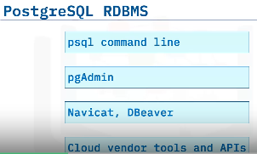
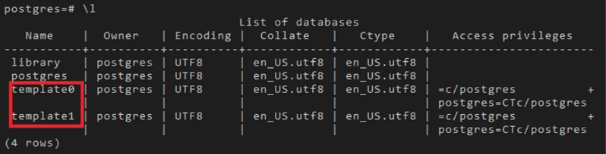
PostgreSQL RDBMS
Open-source DBMS
Relaiable & Flexible
Supports relational & Non-relational data types
Use case/Popular : OLTP, Data Analytics, GIS (Geographic Information System)
Supports all OS
Cloud: VMs or Containers, or Cloud based Managed services (AWS,GCP,IBM,Azure)
Psql CLI

Slide 16
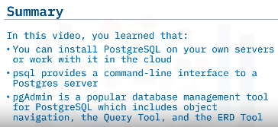

Slide 17
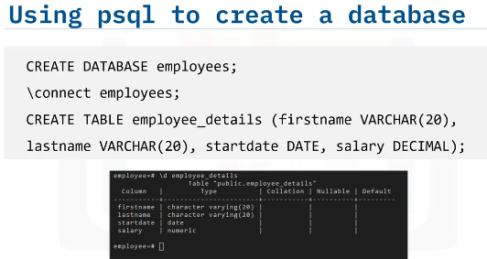
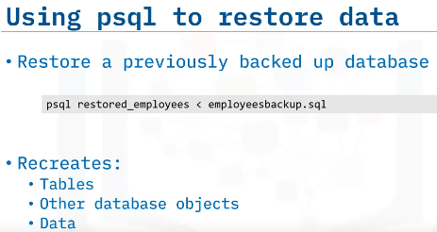

Slide 18
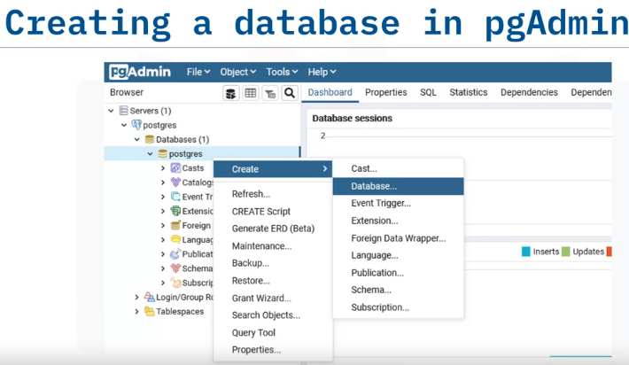

Slide 19
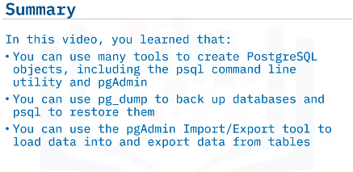

Slide 20
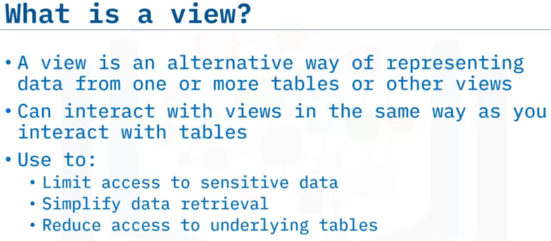
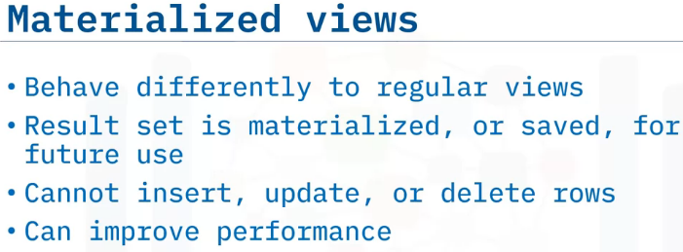
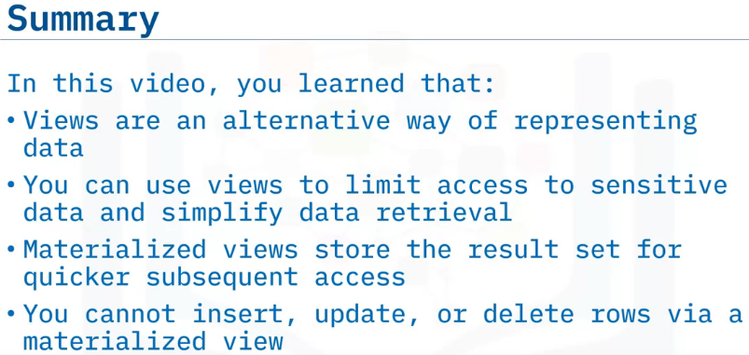
Views
If we need ‘user_name’ and their ‘email_id’ for our frequent use which are located in 2 different tables, we can save such query as a VIEW for our future/frequent use.
In pgAdmin such function is available under schema tab/tree.

Slide 21
Summary & Highlights
PostgreSQL is an open-source object-relational database management system that you can download and install on your own systems or access on the Cloud.
You can either self-manage a Cloud instance of PostgreSQL or use a managed services provider, including IBM Cloud Databases for PostgreSQL, Amazon RDS, Google Cloud SQL for PostgreSQL, EnterpriseDB cloud, or Microsoft Azure for PostgreSQL.
PostgreSQL includes several options for creating databases and tables, loading and querying data, and importing and exporting data relational databases:
The psql command line interface. You use this CLI to run SQL statements.
pgAdmin. A graphical interface to the database server, which is available as a desktop application or as a web application that you can install on your web servers.
Navicat and Dbeaver. Commercial graphical interface options that you can use to access PostgresSQL, MySQL, and other types of databases.
Cloud vendor tools and APIs.
Using pgAdmin, you can:
Use pg_dump to back up databases and psql to restore them.
Use the Import/Export tool to load data into and export data from tables.
Using views:
You can use views to limit access to sensitive data and simplify data retrieval.
Views can be materialized, which means that the view store the result set for quicker subsequent access.
Materialized views enhance performance because the view is saved and often stored in memory. However, you cannot insert, update, or delete rows in a materialized view, and they must be refreshed before you can see updated data.

Slide 23
